Slide 1
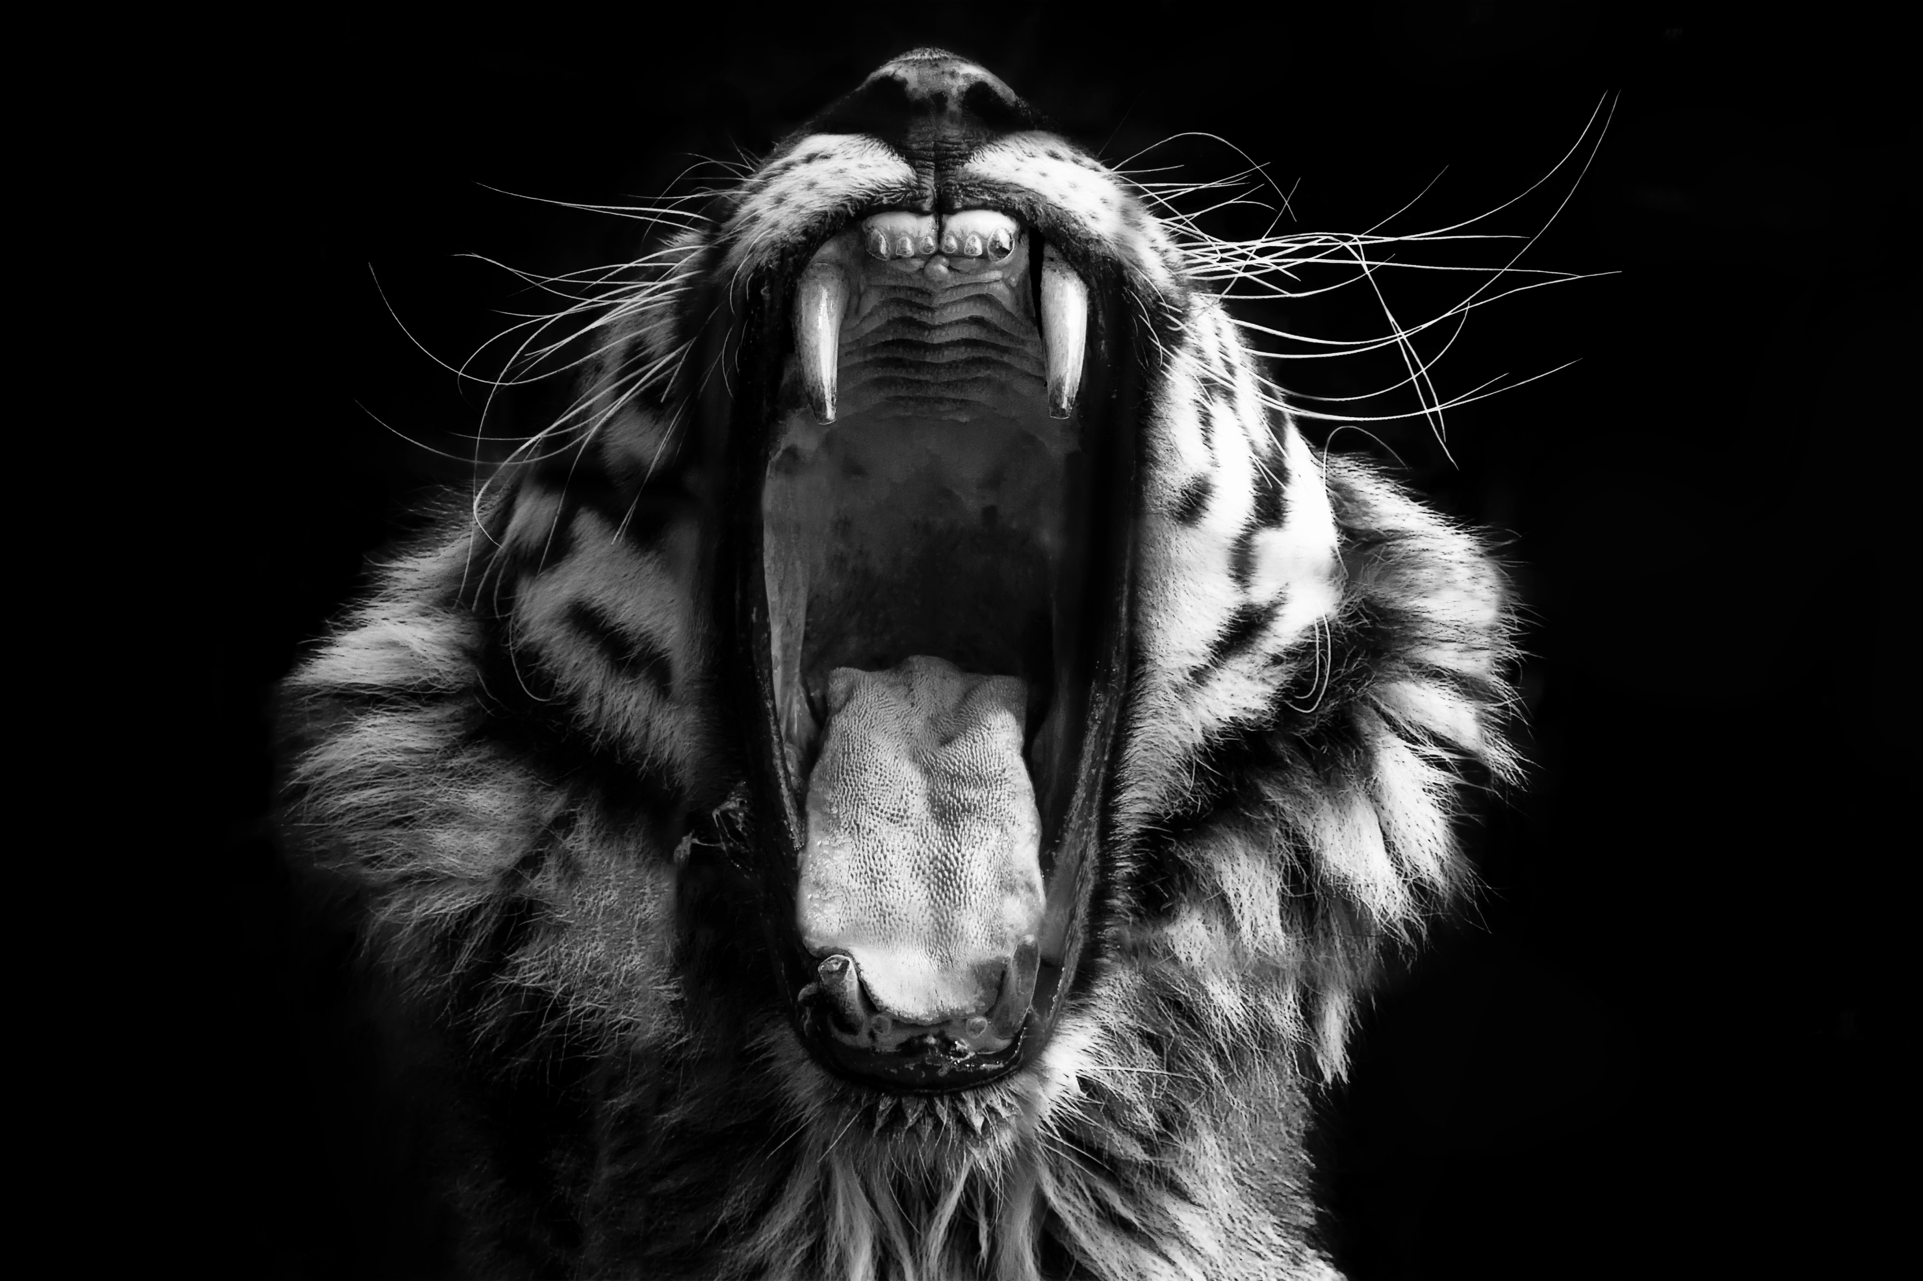
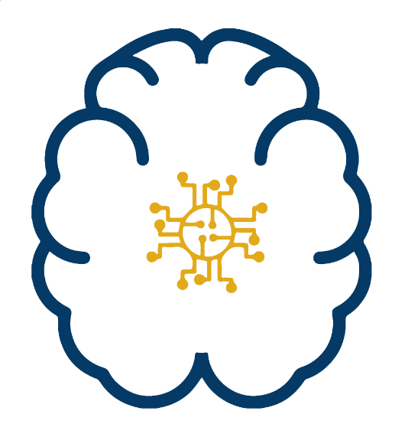

Connecting Neuroscience and Machine Learning Don’t get Eaten by the Tiger
Dr John Butler TU Dublin (Lecturer in Mathematics and Statistics)
TCD (Assistant Professor in Physiology)

Slide 2
Neuroscience
The study of the Brain

Slide 3
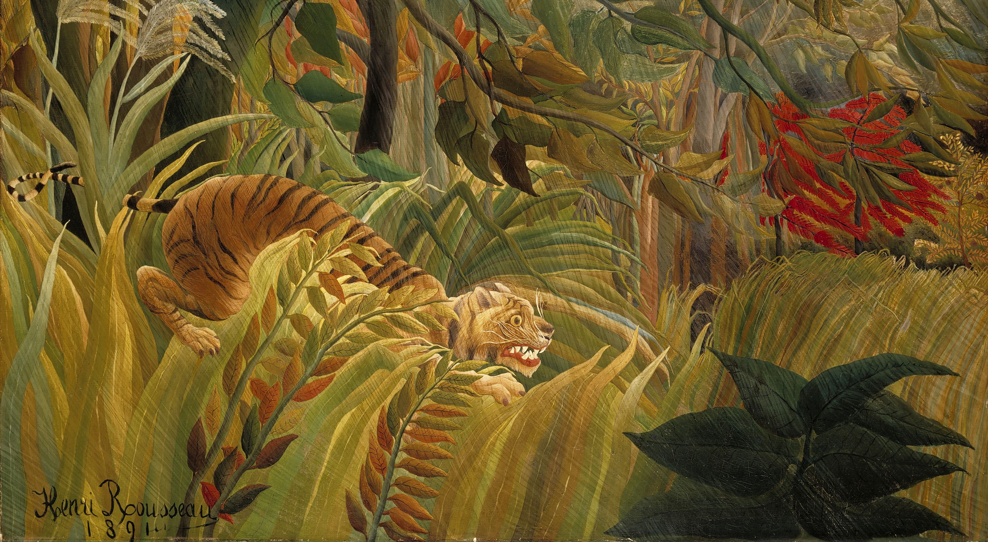
Visual System
Object Classification Tiger or Tree
Motion Detection Am I moving Is the tiger moving
Motion Discrimination Which Direction am I moving
Which Direction is the tiger

Slide 4
Questions for You
What is the brain made of?
Water
Protein
Fat
Veins
Glial Cells
Neurons

Slide 5
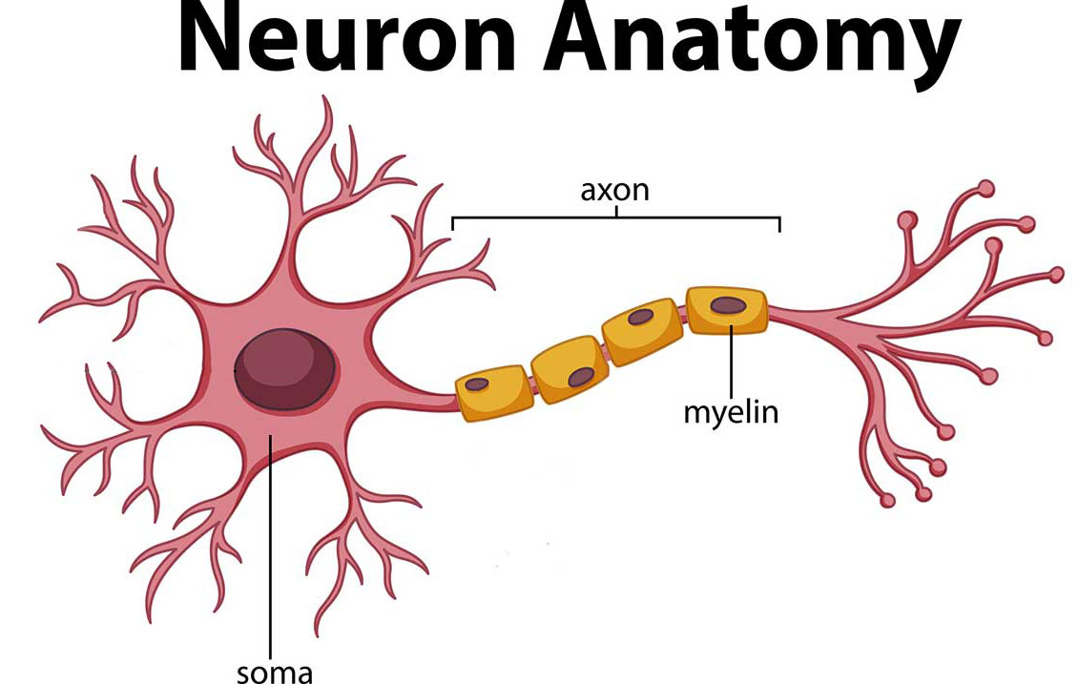
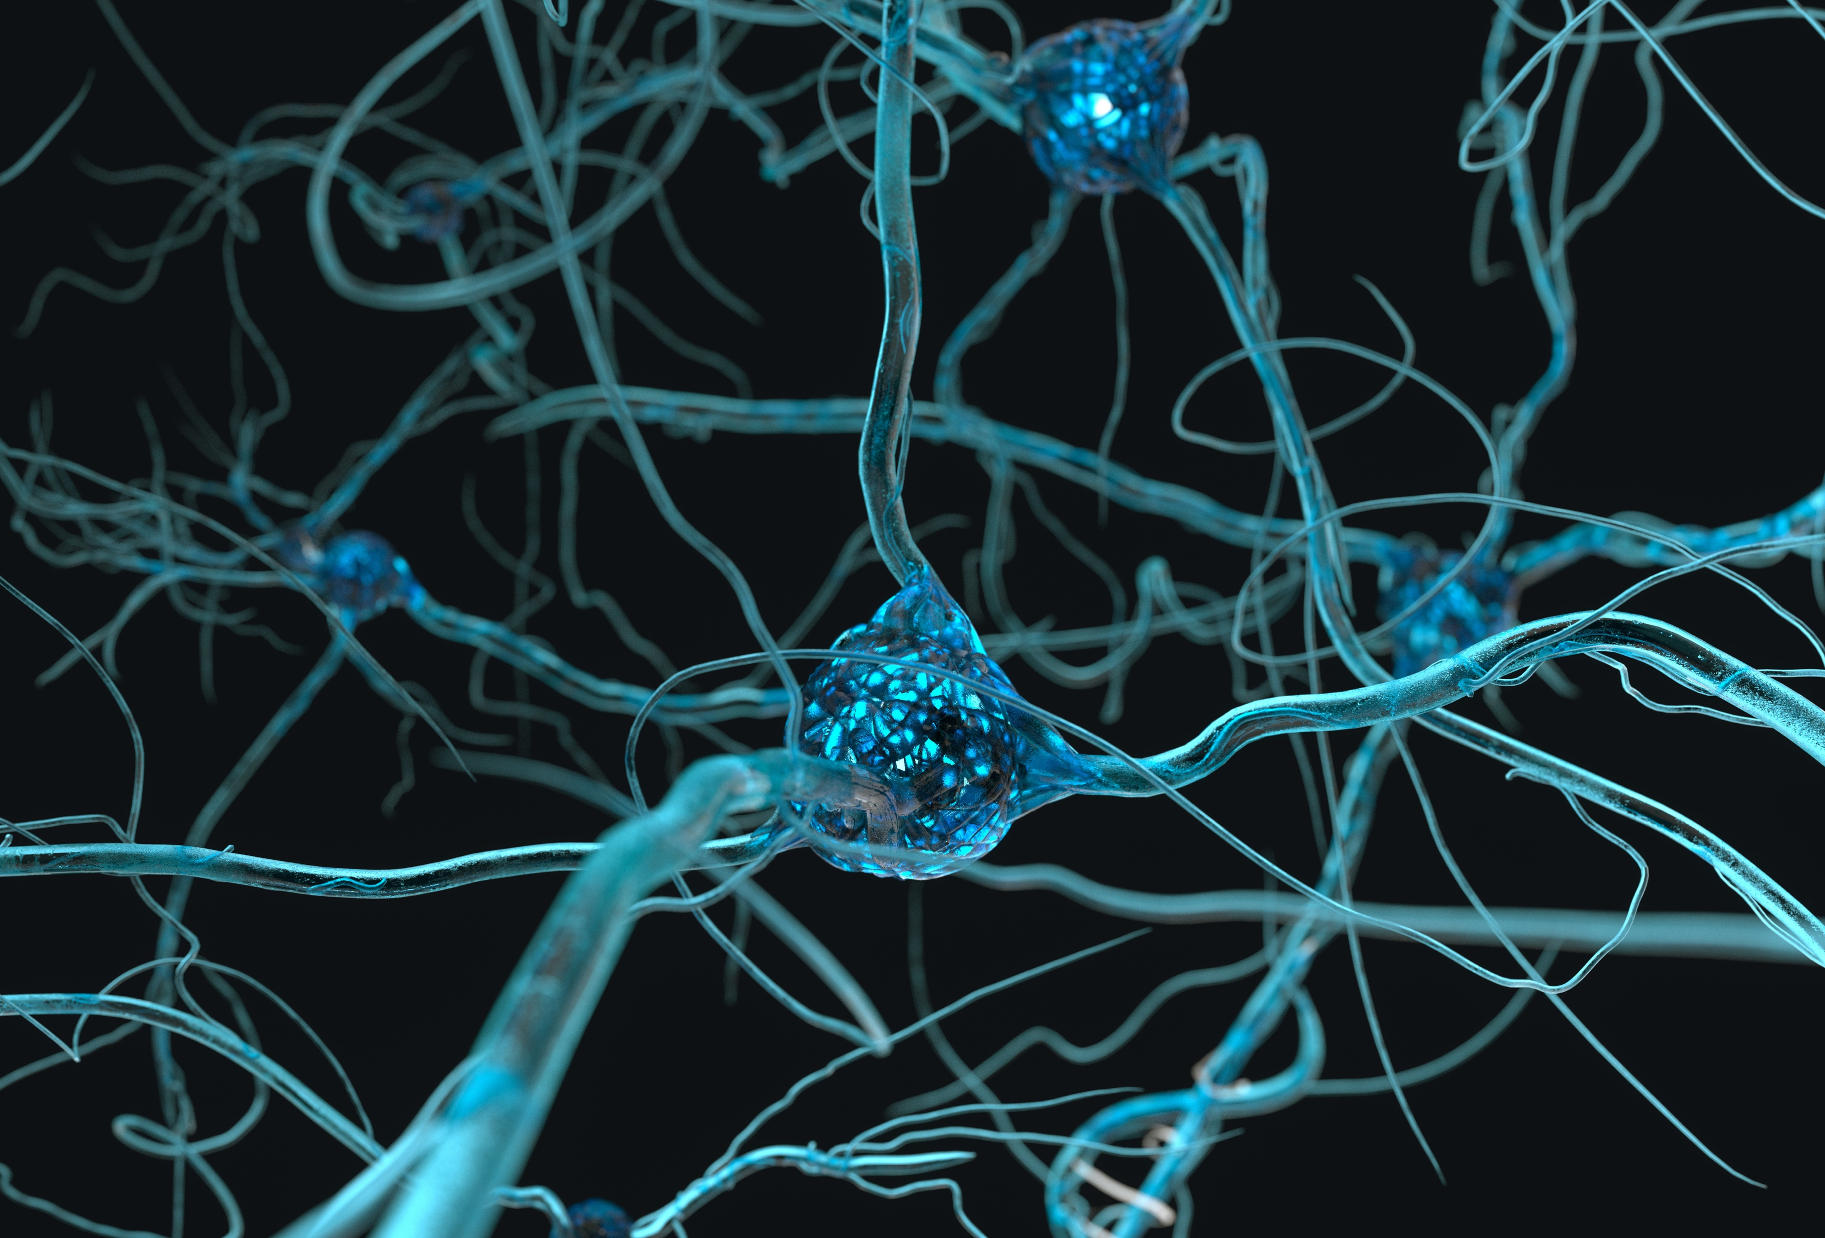
What Does a Neurons Look Like
How Many Neurons?
100,000,000,000

Slide 6
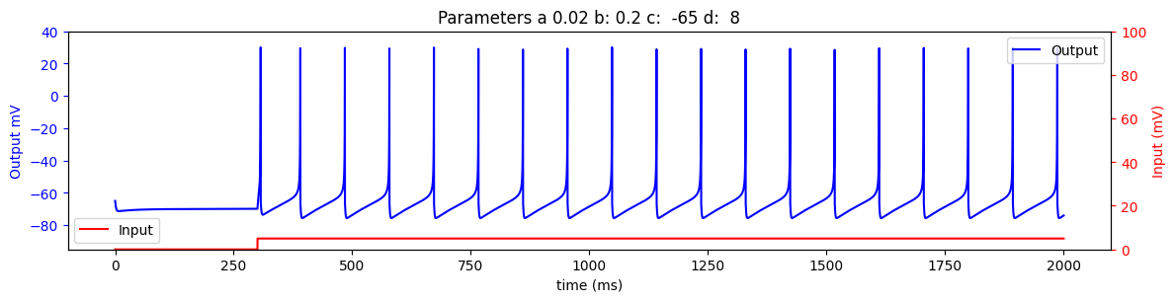

How Does a Neurons Work
Spike
0
1

Slide 7
Volunteer A Neuron

Slide 8
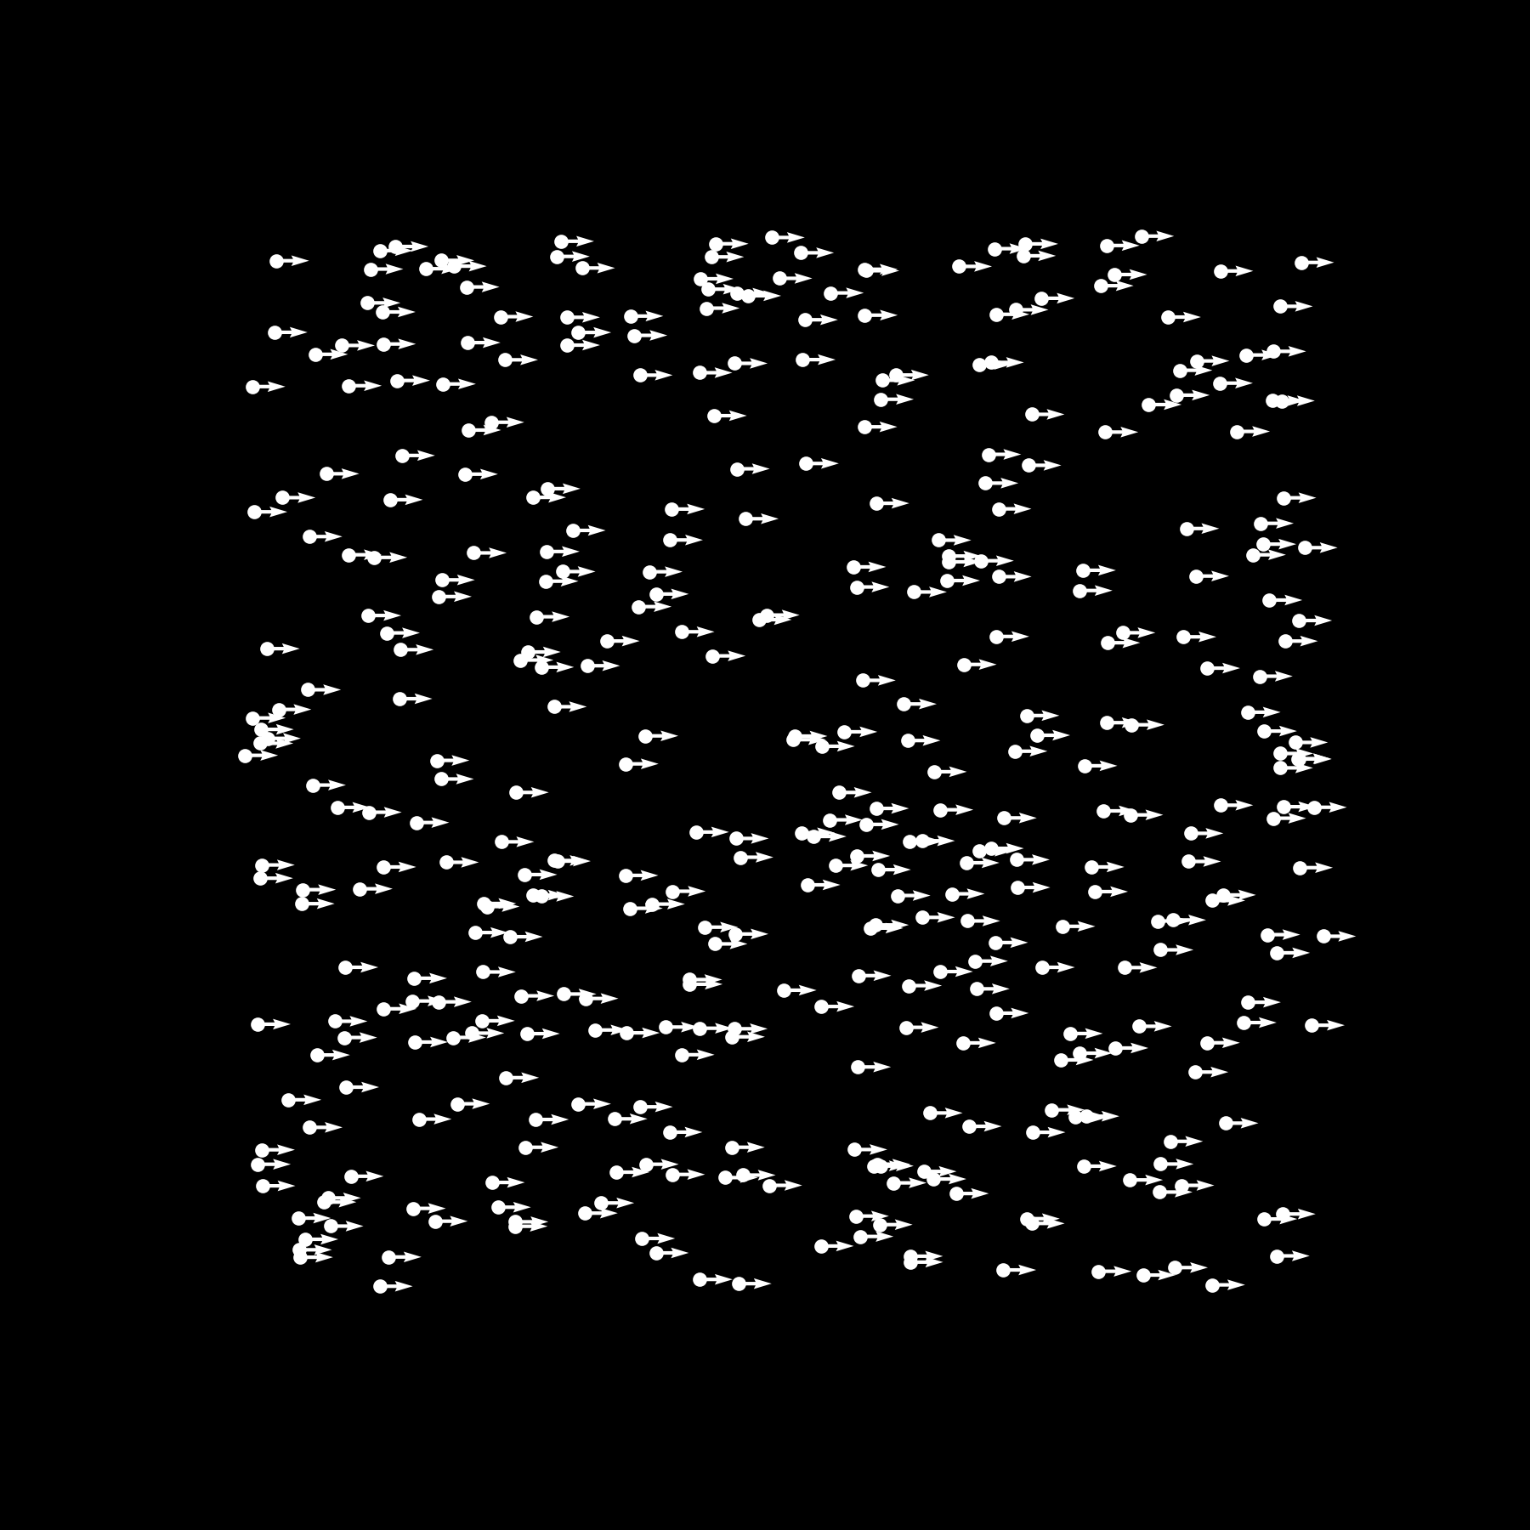
Is the Tiger Coming for Me

Slide 9
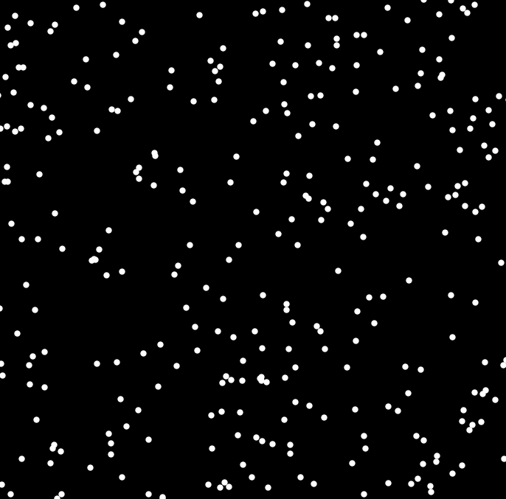
Left Or Right?
No Noise

Slide 10
How do Neurons Work Together?
100,000,000,000 Neurons
each with
10,000 connections
1,000,000,000,000,000 connections

Slide 11
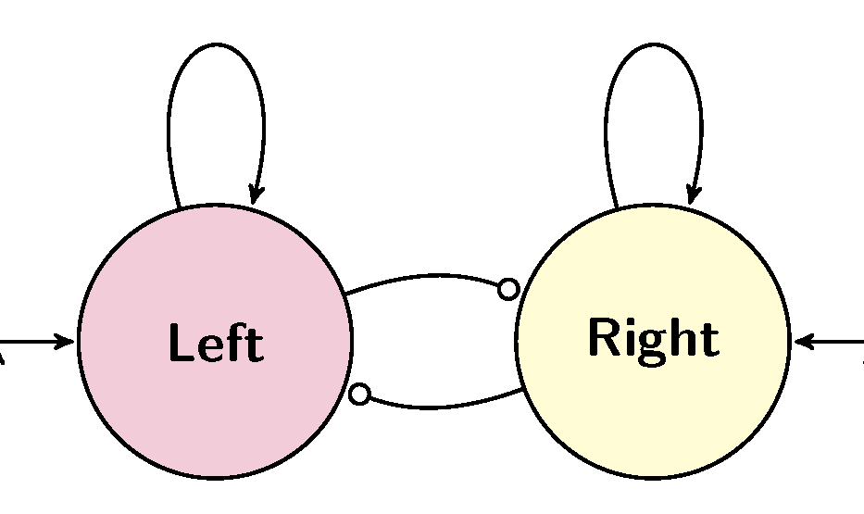
Two Areas
Let’s get a everyone to be two groups of Neurons
A Left side and a Right side
The most votes is the decision
But is it the correct decision

Slide 12
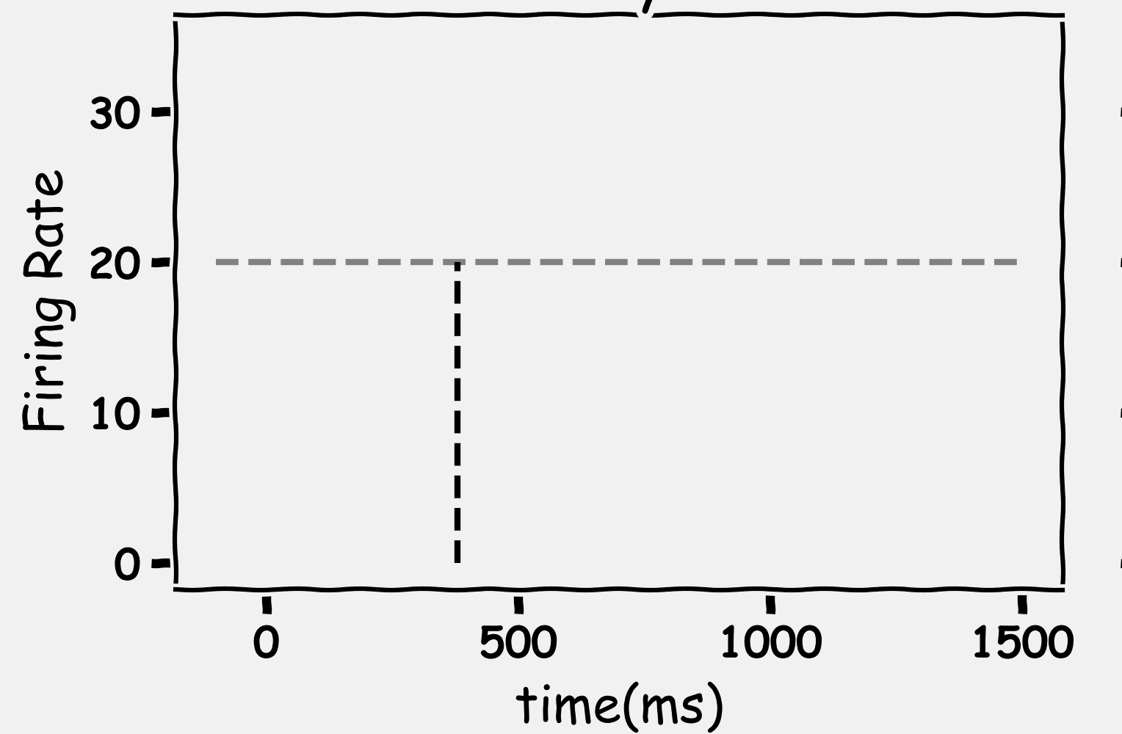
A Quick Decision
Time

Slide 13
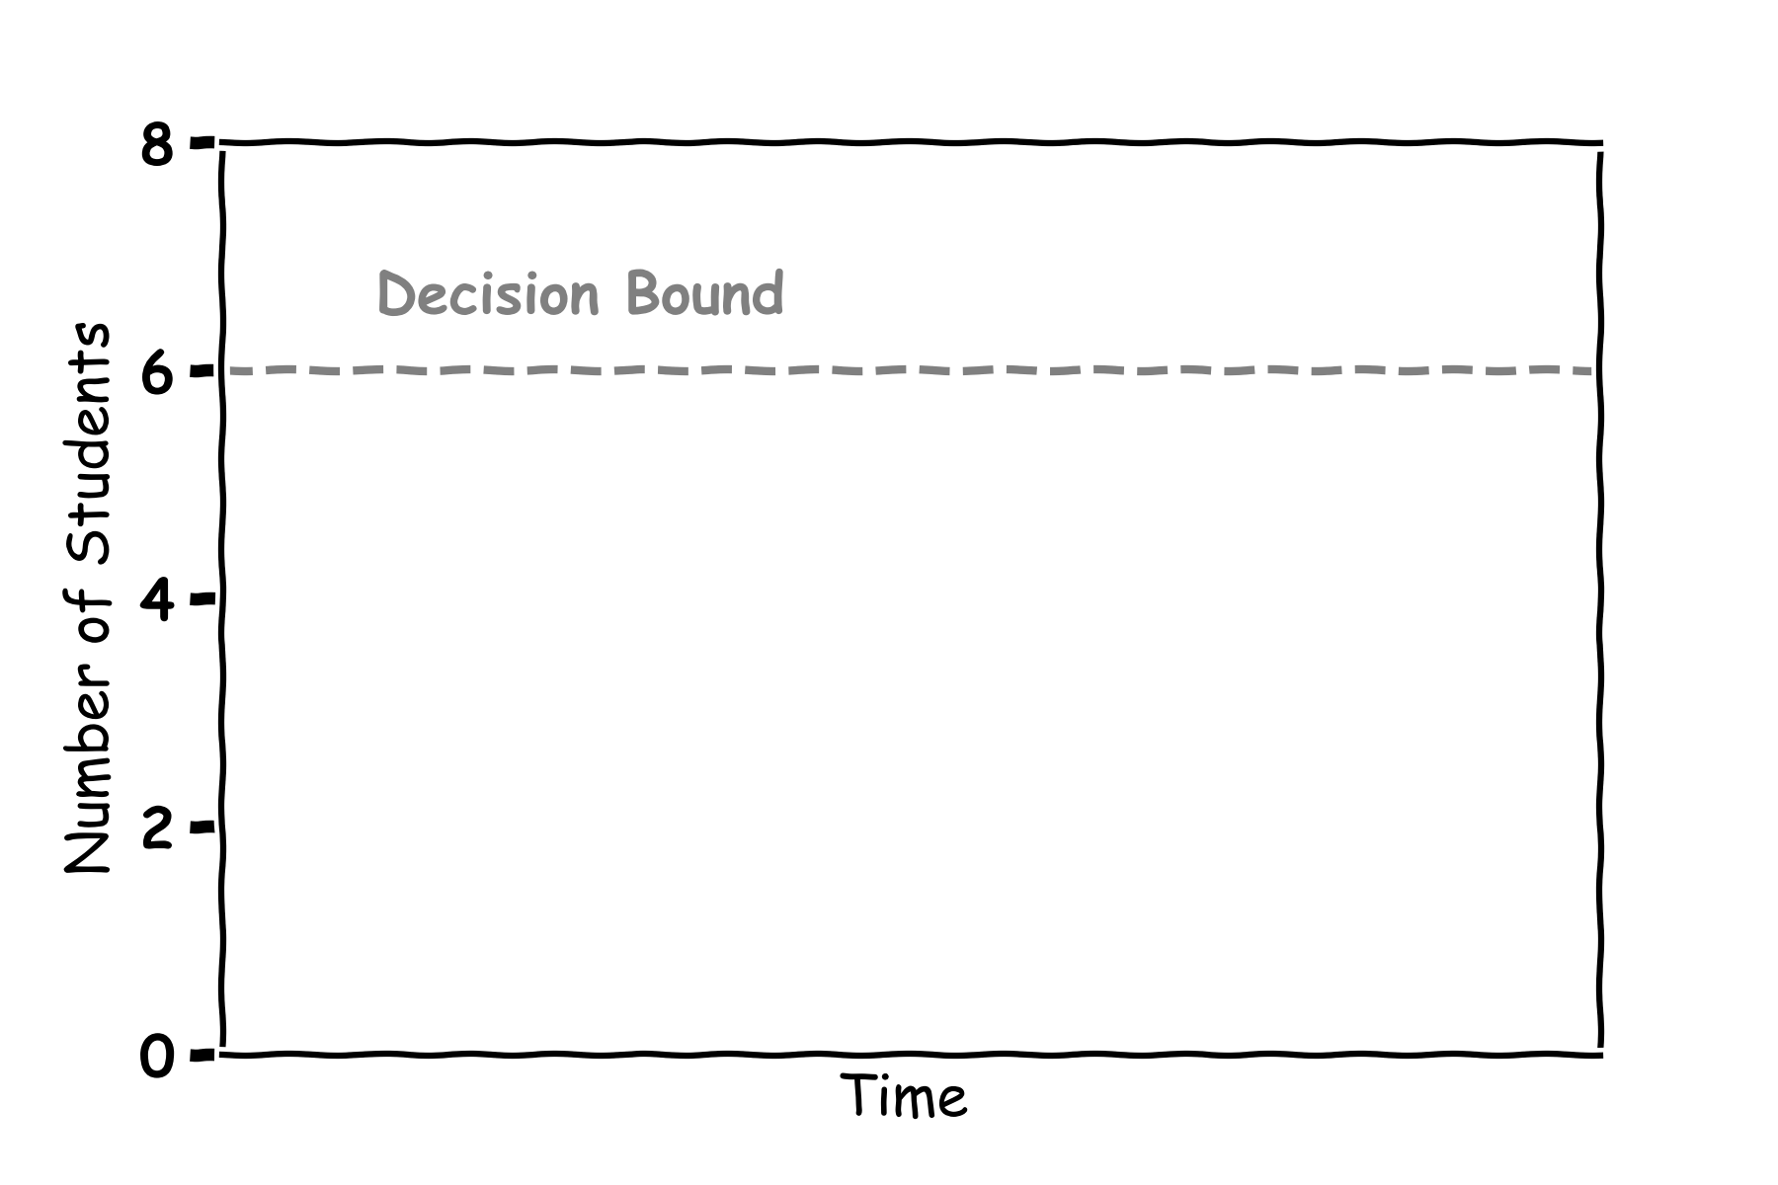
A Quick Decision

Slide 14
Left Or Right?
No Noise

Slide 15
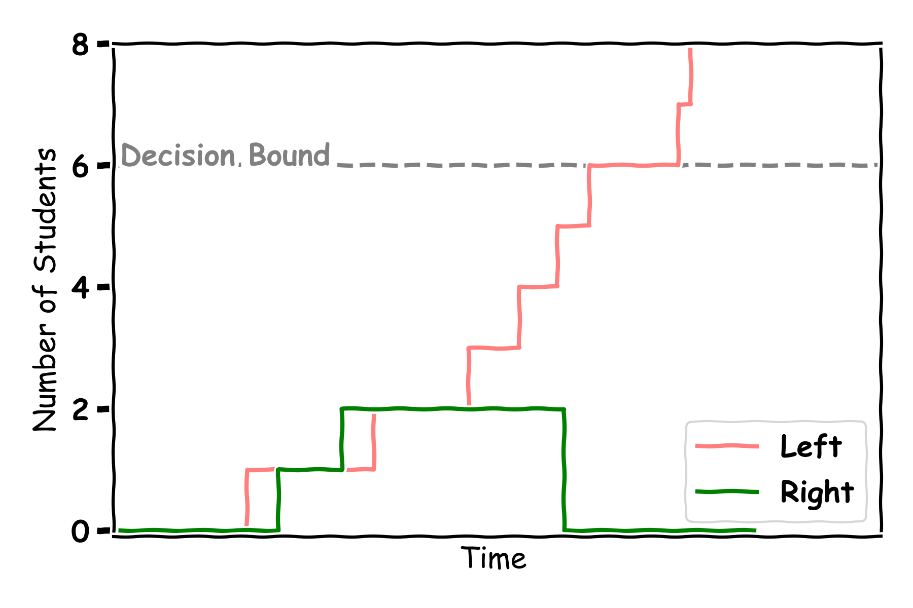
Left Decision

Slide 16
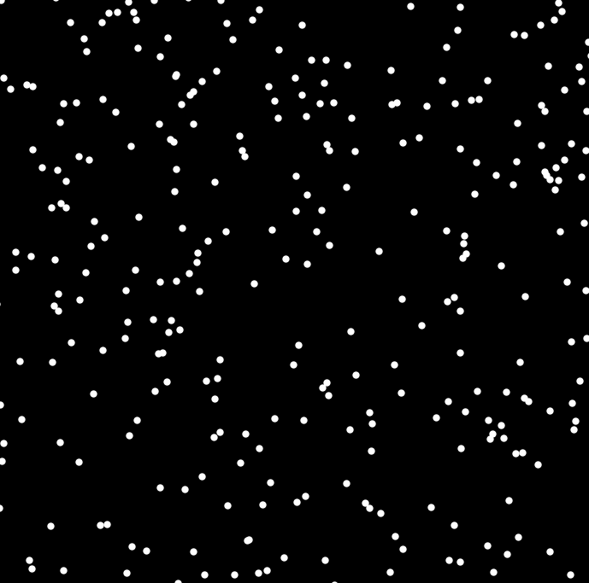
Left Or Right?
No Noise

Slide 17
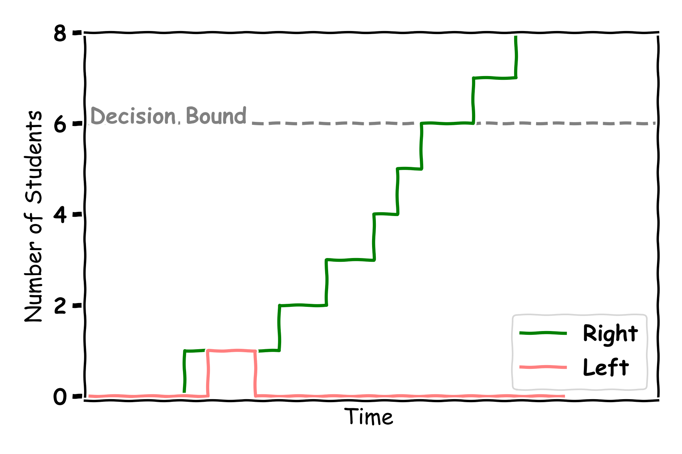
Right Decision

Slide 18
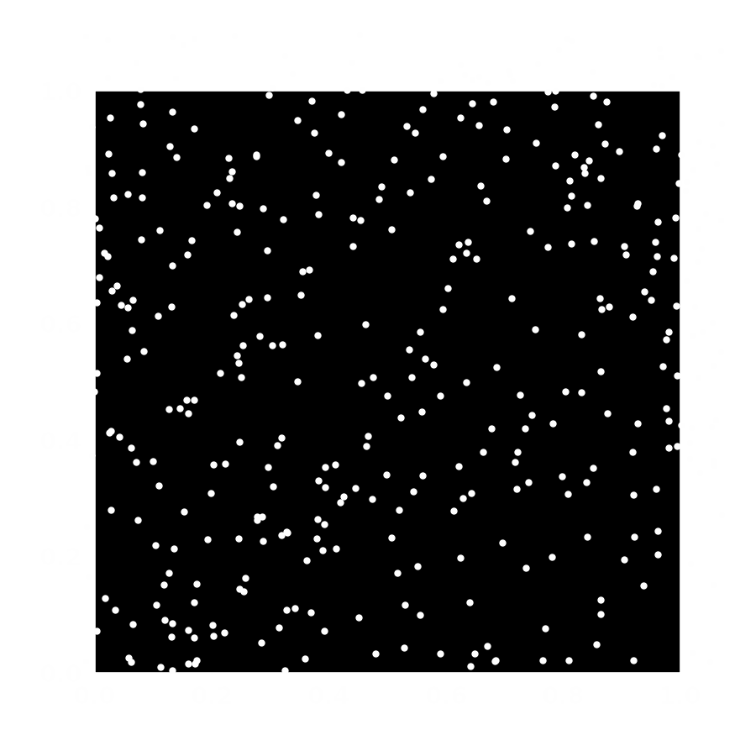
Left Or Right?
Right
Some Noise

Slide 19
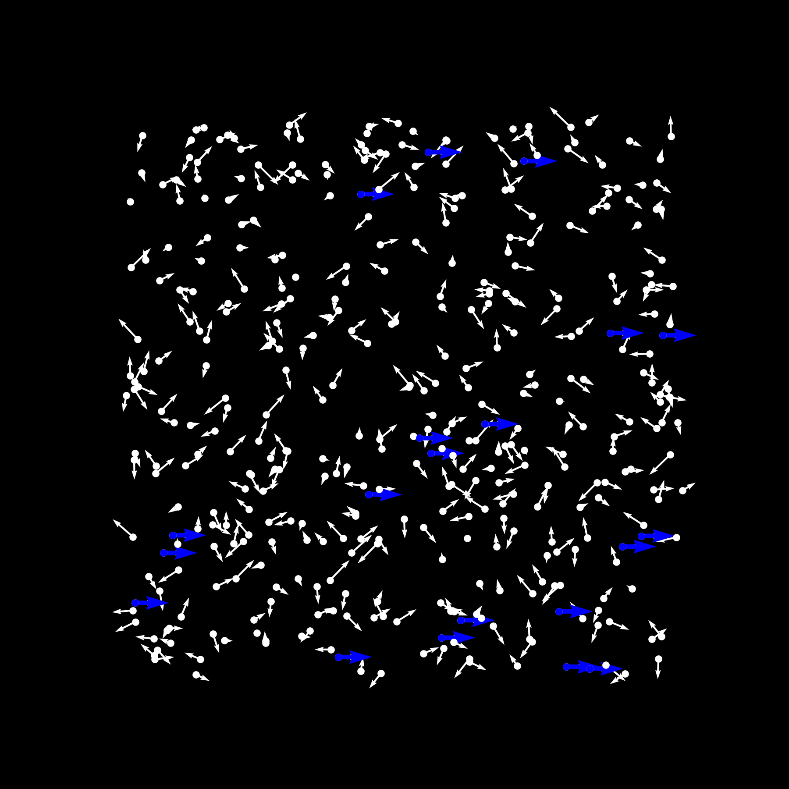
Snapshot
Right

Slide 20
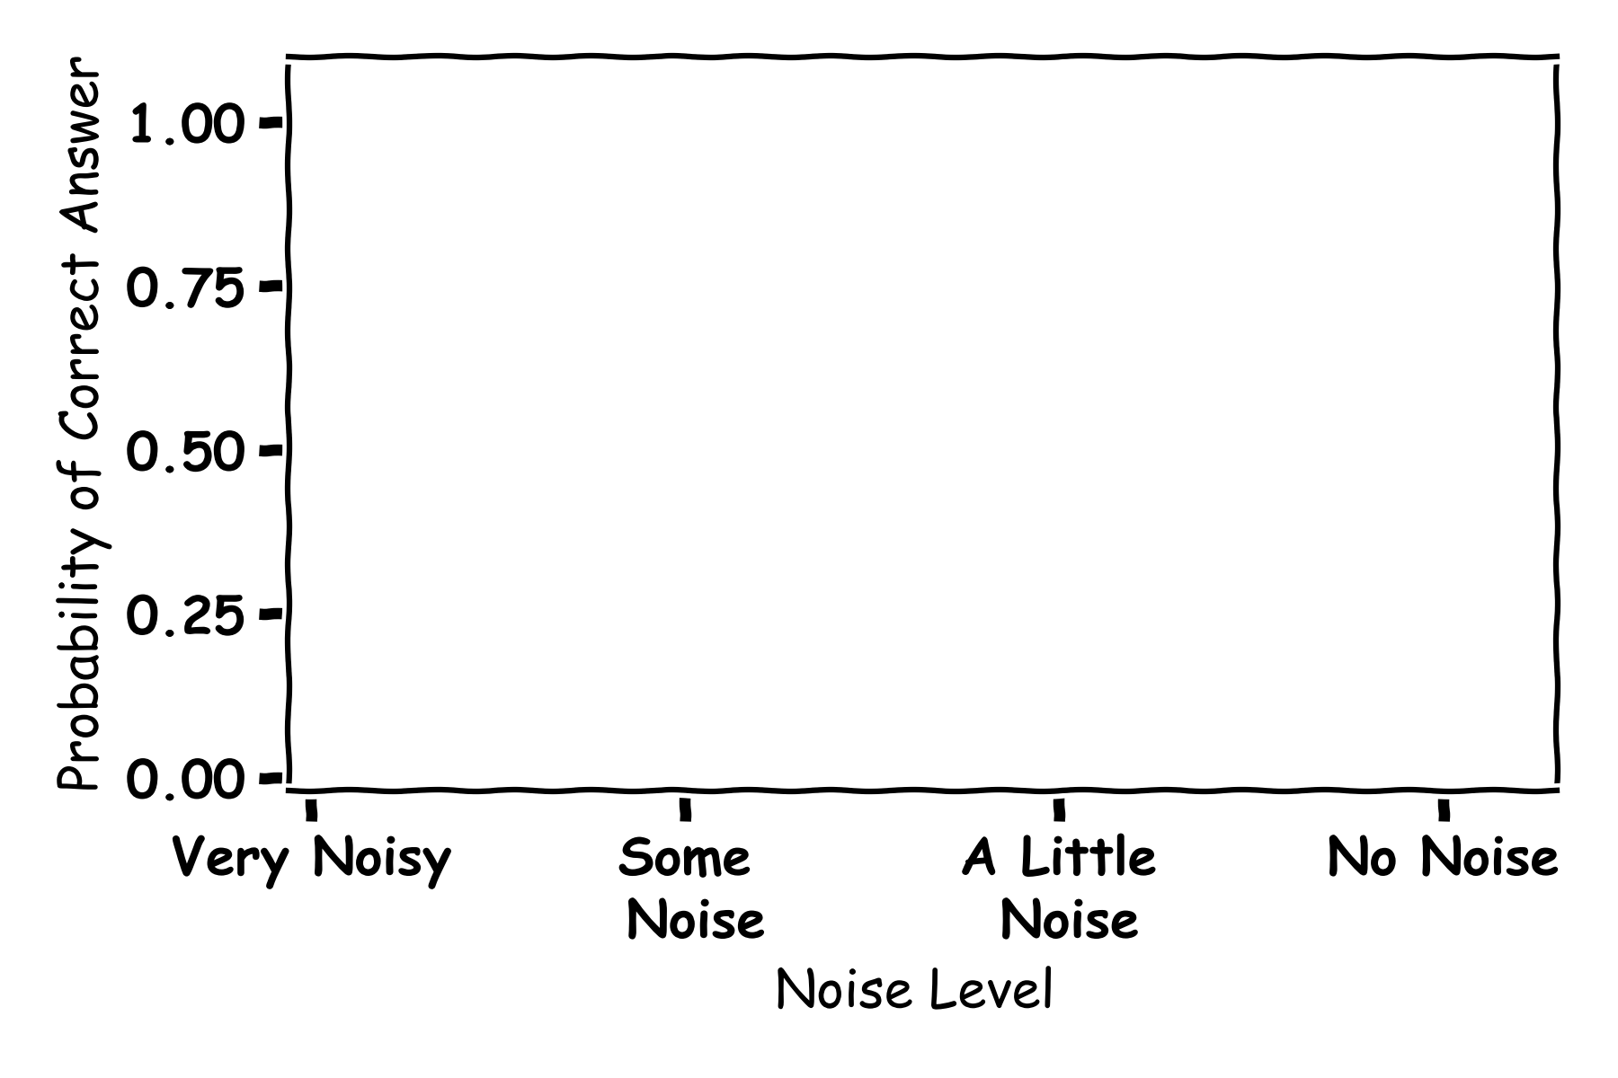
Noise

Slide 21
Left Or Right?
No Noise

Slide 22
Left Or Right?
No Noise

Slide 23
Left Or Right?
No Noise

Slide 24
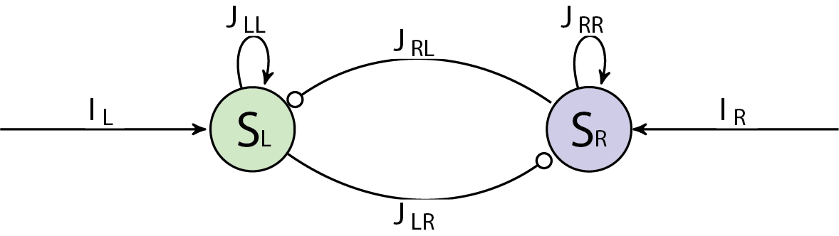
Two Areas
The most votes is the decision

Slide 25
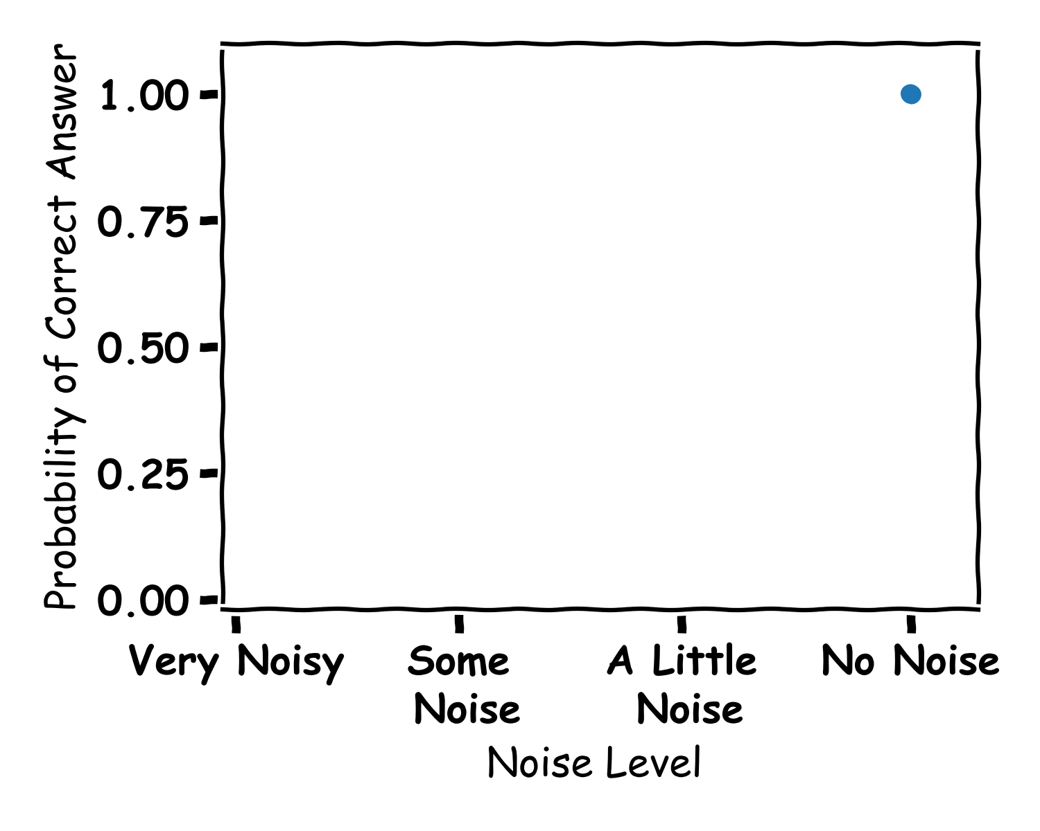
Answers

Slide 26
Left Or Right?
Right
A little Noise

Slide 27
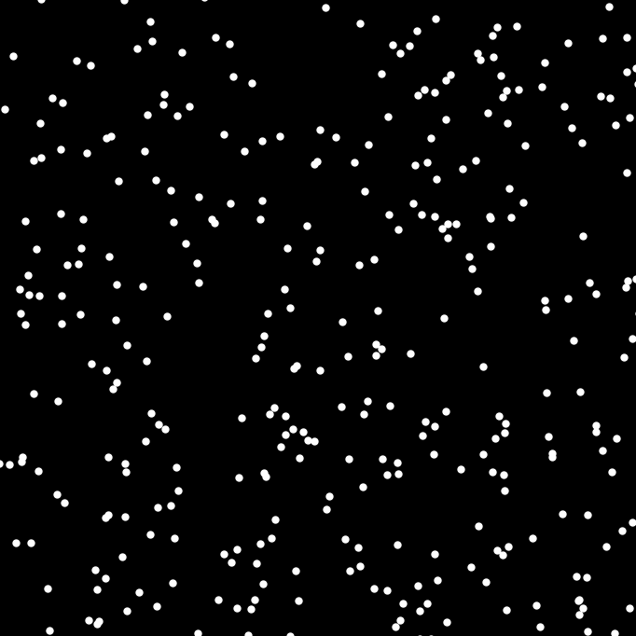
Left Or Right?
Some Noise

Slide 28
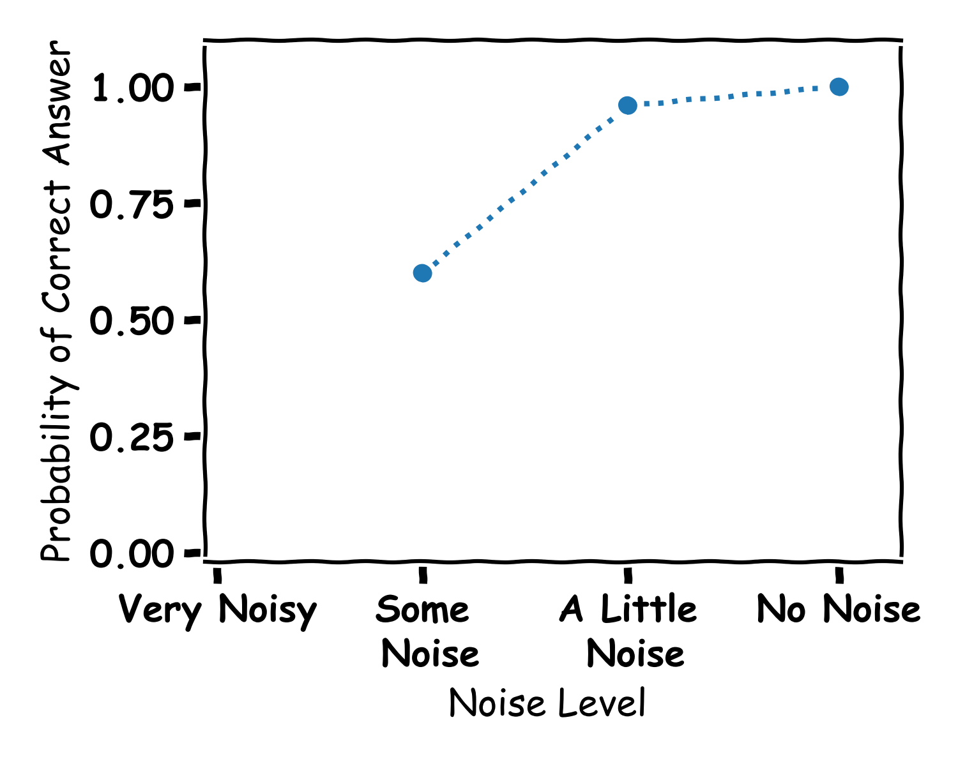
More Answers

Slide 29
Left Or Right?
Loads of Noise

Slide 30
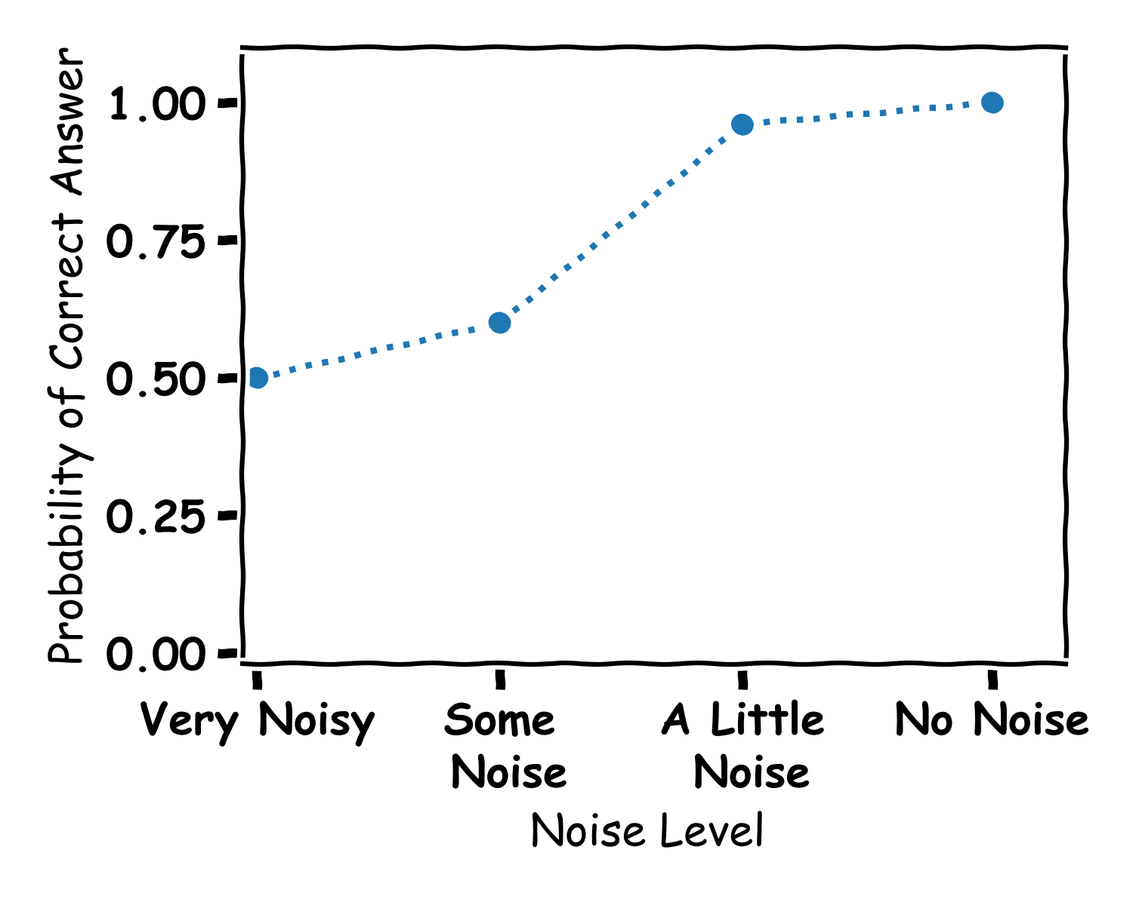
Answers

Slide 31
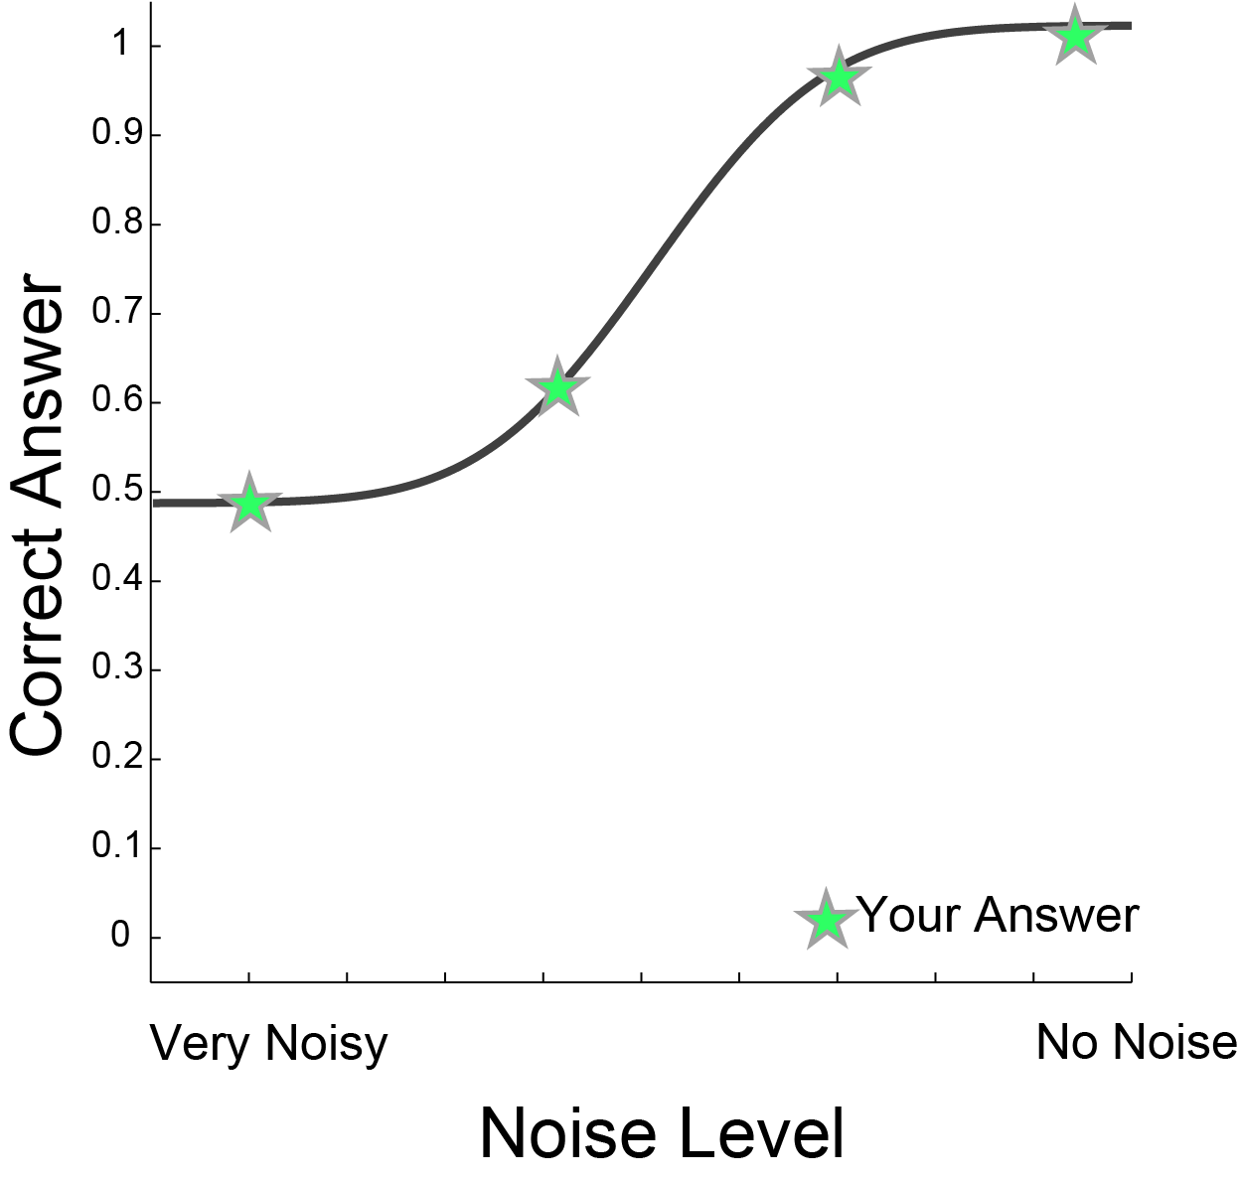
More Answers

Slide 32
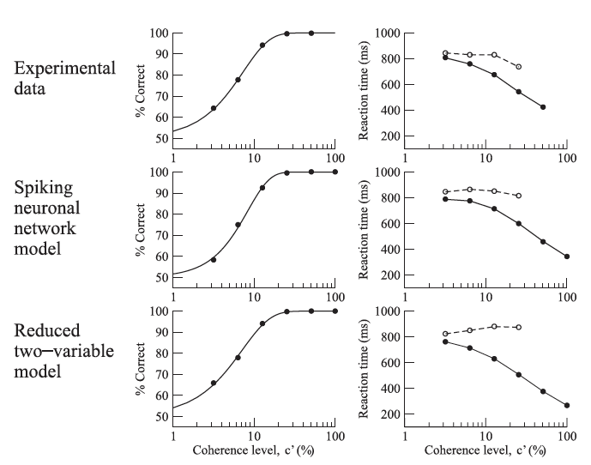
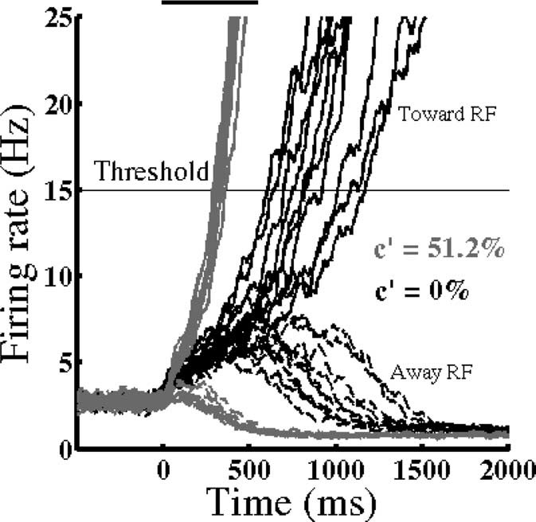
Modeling Directions
Model output
Mapped to Decisions
Wong and Wang 2006

Slide 33
Machine Learning
Algorithms

Slide 34
What is Machine Learning
Machine learning is teaching computers to learn and make decisions.
Well animals are good at learning and making decisions
Let’s try to do it like them

Slide 35
Visual System
Object Classification
Tiger or Tree
Motion Detection Am I moving Is the tiger moving
Motion Discrimination Which Direction am I moving
Which Direction is the tiger

Slide 36
Perceptron (node)
Input
Node
Output
A BIT OF MATHS
0
1

Slide 37
Perceptron (node)
Input
Node
Output
A BIT OF MATHS
0
1

Slide 38
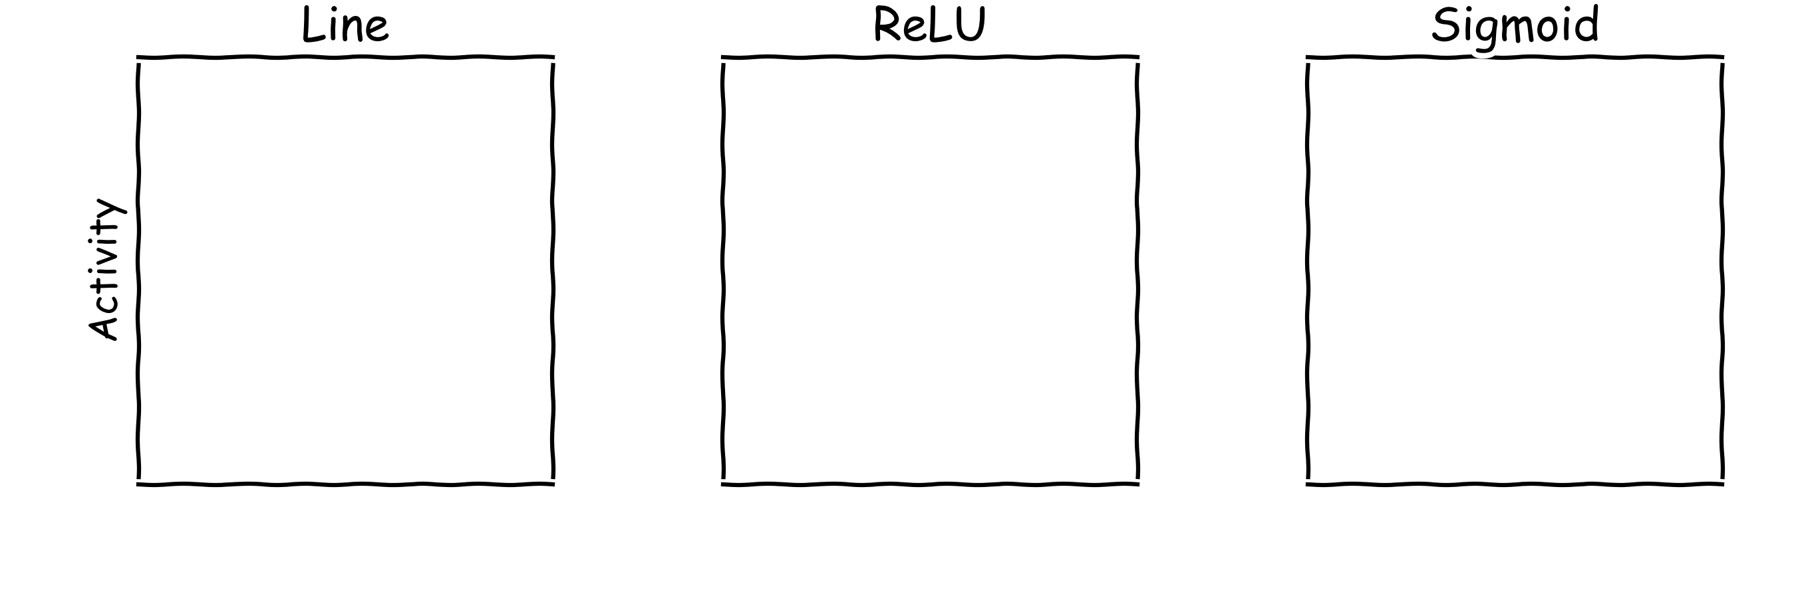
Activation Function

Slide 39
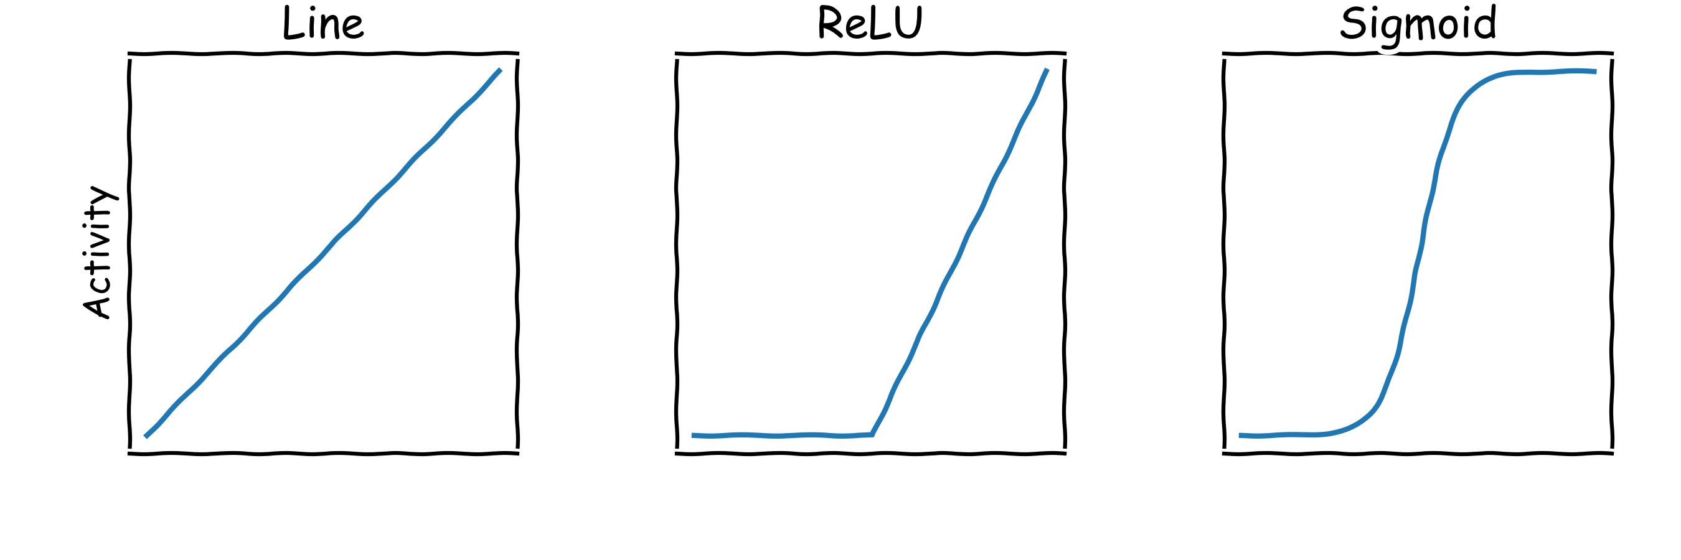
Activation Function

Slide 40
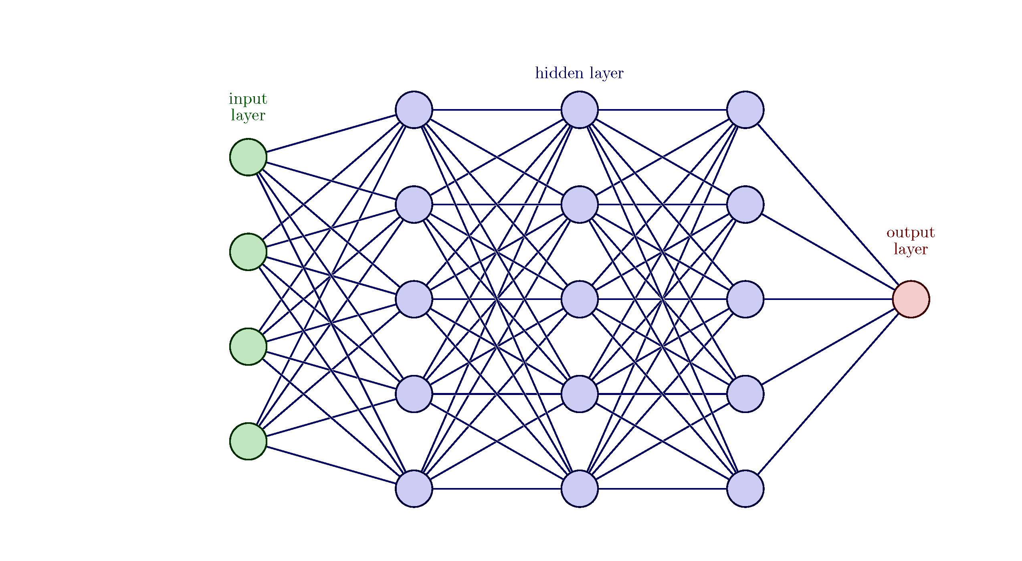
Loads of Nodes an Artificial Neural Network
Input
Neural Network
Output

Slide 41
How does it learn?
It must learn the connections
Input
Neural Network
Output

Slide 42
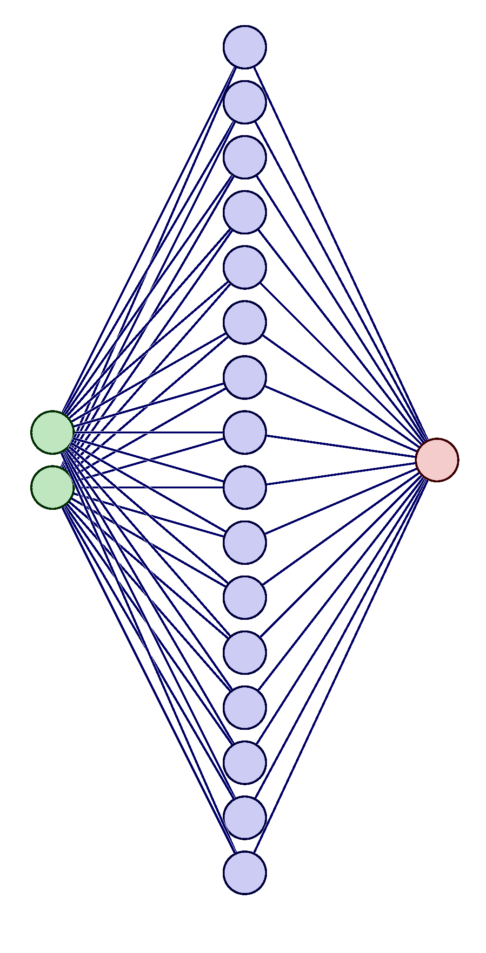
How does it learn?

Slide 43
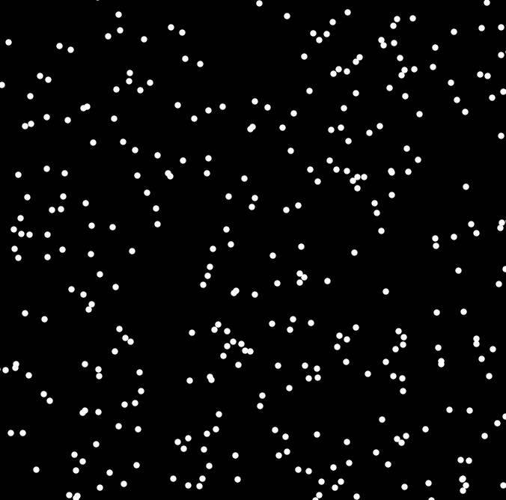
Left Or Right?
Some Noise

Slide 44
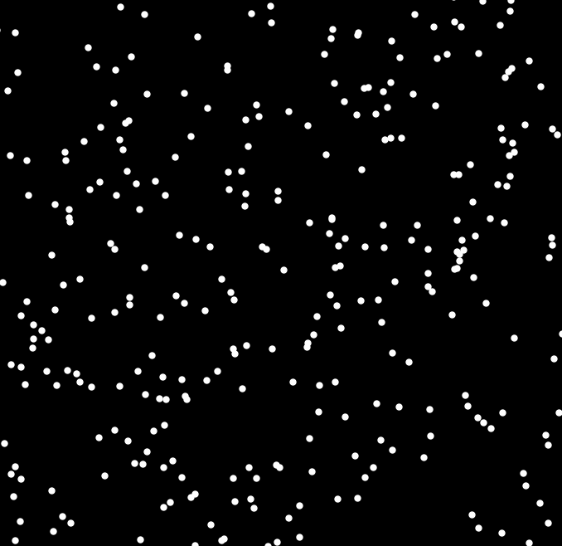
Left Or Right (again)?
Some Noise

Slide 45
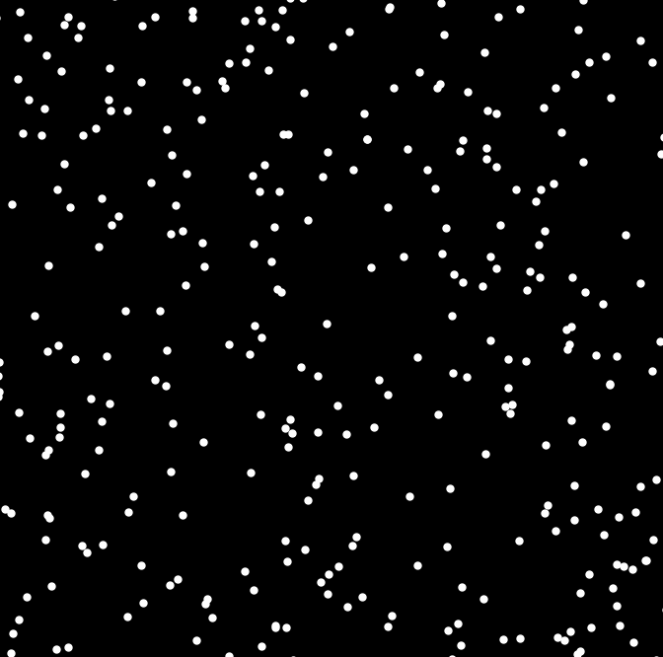
Left Or Right (again and again)?
Some Noise

Slide 46
What does it learn?

Slide 47
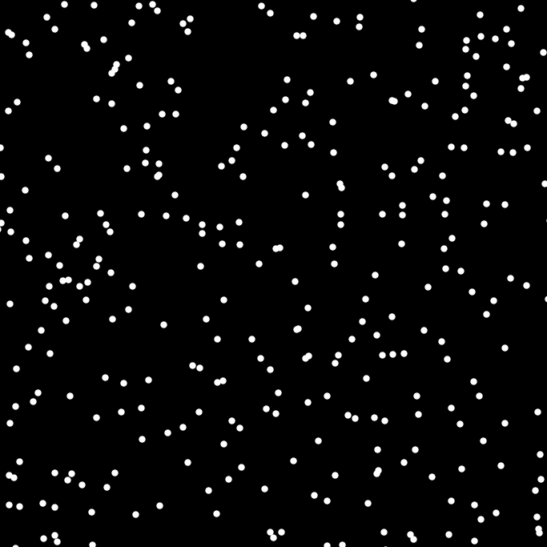
Left Or Right?

Slide 48
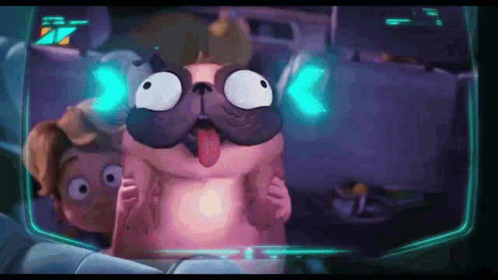
Neural Networks
You are smarter than a computer
Cannot answer if it is not trained on (seen) it

Slide 49
Uses of Neural Networks
Image Recognition
Speech Recognition
Playing Games.
Creating Art
Language Translation.
Medical Diagnosis.

Slide 50
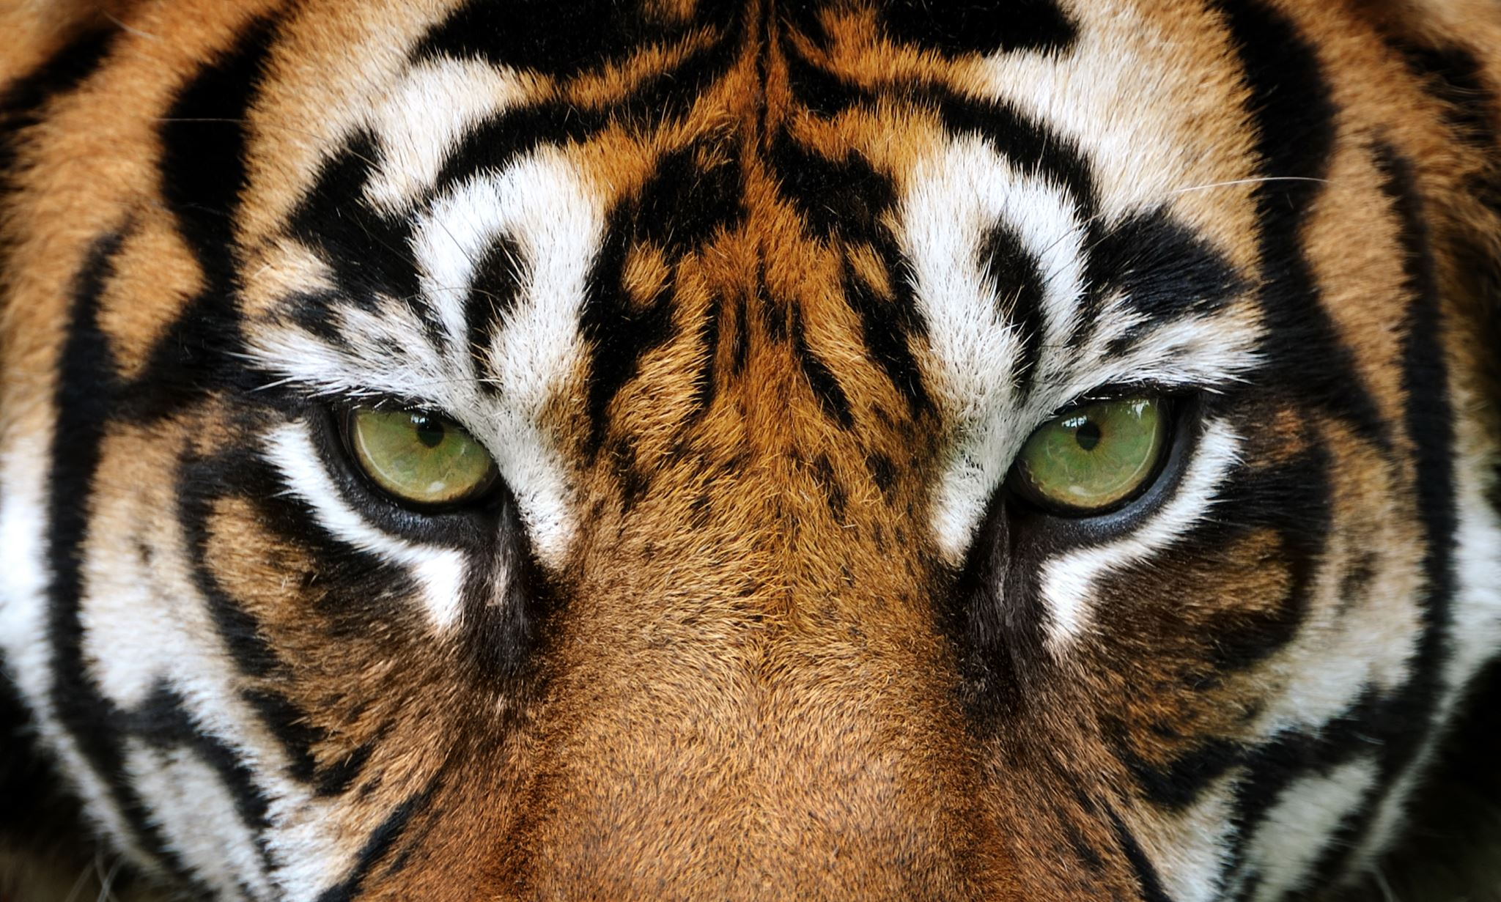
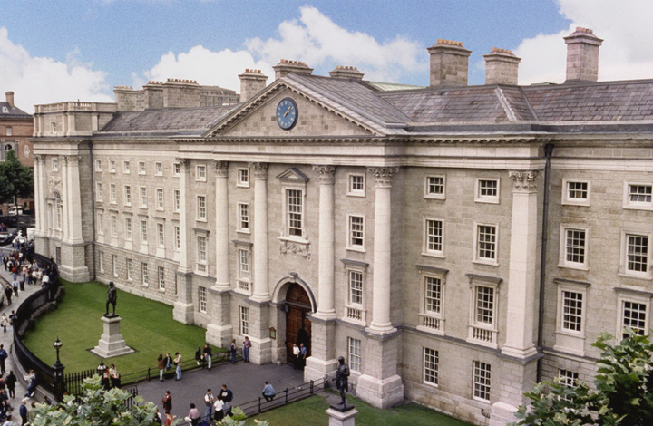
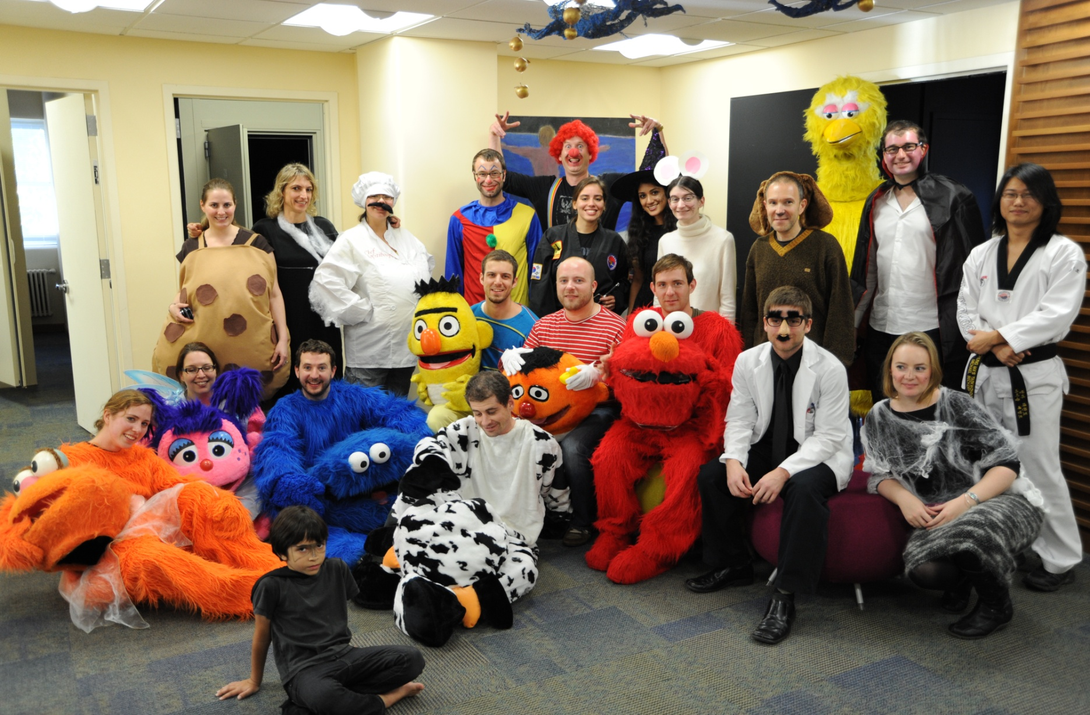
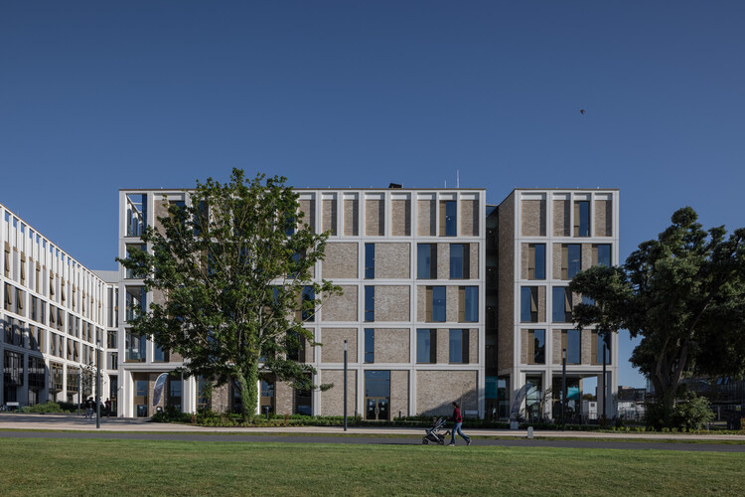
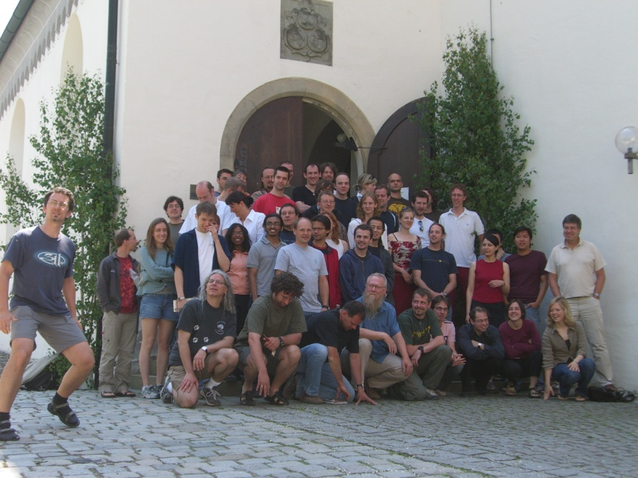
Thank you for Listening
TCD
Albert Einstein College of Medicine
TU Dublin
Max Planck Institute Germany

